Slide 1
IEEE Phoenix Senior Design Project, Spring 2011 _x000b__x000b_Blood Pressure Sensor _x000b_Accuracy and Precision Requirements
Larry Beaty (labeaty@ieee.org)
Steven James
Michael Callaghan
Copyright 2011 Larry A. Beaty. Copying and distribution of this document is permitted provided this notice is retained.

Slide 2
Who Are We?
Twin Cities IEEE Phoenix Project
  Volunteer electrical/mechanical/software engineers
  Our group was assembled to productize results of research done at the Chronobiology Lab and elsewhere
  Open Source hardware project to design and build a blood pressure monitor that is inexpensive, unobtrusive, easy to use and collects a week of blood pressure measurements.
UMN Halberg Chronobiology Lab
  Dr. Franz Halberg, “Father of American Chronobiology”
  Chronobiological Interpretation of Blood Pressure
    Vascular Variability Disorders more important than hypertension
  Our “customer”
Copyright 2011 Larry A. Beaty. Copying and distribution of this document is permitted provided this notice is retained.
Notes:
Open source – we aim to give away our designs and implementations to blood pressure manufacturers. We want low-cost continuous monitors on the market, and we hope that competition between the manufacturers and the fact that we’ve done the R&D for them will keep the final cost low.
Though Open Source is in it’s infancy, many companies are interested in it, and recognize that it has value.
Dr. Halberg is an amazing man. 91.6 years old today, and still works at the university 7 days/week.
The chronobiological interpretation of blood pressure is about 30 years old now, but still not in use in mainstream healthcare due to lack of a good monitor.

Slide 3
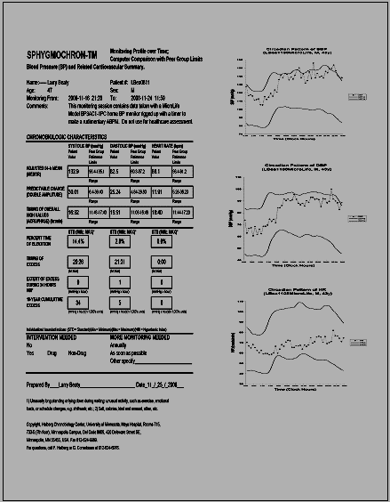
Background
The
Sphygmochron
Report
Results from
Continuous
Monitoring
Copyright 2011 Larry A. Beaty. Copying and distribution of this document is permitted provided this notice is retained.
Notes:
There is much more data here than the three numbers you get from your doctor: systolic pressure, diastolic pressure, and heart rate. That’s why it can detect vascular variability disorders that your doctor can’t with only 2 readings per year.

Slide 4
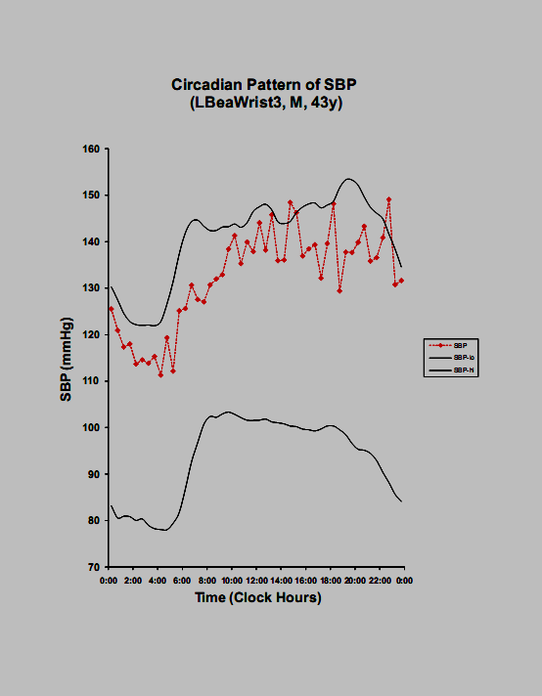
Background
The
Sphygmochron
Report
Results from
Continuous
Monitoring
Copyright 2011 Larry A. Beaty. Copying and distribution of this document is permitted provided this notice is retained.
Notes:
An example of systolic pressure varying through one day. The black lines show the healthy range for a subject’s age and gender. The red line is the actual readings. What percent of the day did this subject spend outside the healthy range? How do we come up with a blood pressure monitor that takes two readings per hour, every hour of every day, for a week?

Slide 5
Where the student project fits in
Over-Simplified Block Diagram of the System
Sensor
Data acquisition and communi-cation
Cell phone or home computer
Data storage and analysis website
Copyright 2011 Larry A. Beaty. Copying and distribution of this document is permitted provided this notice is retained.
Notes:
The student projects are aimed at experimenting with sensors that meet requirements in the areas of cost, reliability, wearability. There is no off-the-shelf sensor the meets our requirements for this, so the idea is to construct a suitable sensor system starting with basic sensor technologies and existing off-the-shelf parts.

Slide 6
What is Pulse Transit Time (PTT)?
The heart beats every 1 second or so
It takes a couple of hundred milliseconds for a pulse to travel (transit) from the heart to extremities
The pulse’s velocity is related to blood pressure (and other things such as compliance of the artery)
Also called Pulse Wave Velocity (PWV)
In theory, you put two pulse sensors along an artery, calculate the transit time (velocity), then derive the blood pressure.
Copyright 2011 Larry A. Beaty. Copying and distribution of this document is permitted provided this notice is retained.
Notes:
In theory, you can put two pulse sensors along an artery and calculate the transit time (or velocity).

Slide 7
Activities in the sensor project
Understand and describe the supplied pulse model, and derive expected transit times and accuracy.
Develop requirements and an error budget for a sensor system to record the shape of individual pulses at two locations on the body to determine adequate blood pressure readings.
Design, build, and test a non-invasive sensor system to record pulse waveforms at two locations on the body (e.g. forearm and wrist).
Publish a final report that will be posted on the Phoenix Project website. (Can be the same as your class report.)
Additional “stretch goals” available
Copyright 2011 Larry A. Beaty. Copying and distribution of this document is permitted provided this notice is retained.
Notes:
Example stretch goals:
Design the system to be battery operated and wearable.
Develop the algorithms and software to determine the pulse transit times.
Determine the calibration constants for test subjects.
Test the system’s accuracy against the cuff pressures at various blood pressures by inducing changes in a subject’s blood pressure with exercise.
Publish an academic paper in a journal

Slide 8
Sensor Technologies to choose from
Piezoelectric
Infrared optoelectronic
Acoustic (sound/microphone)
Impedence Plethysmography
Your ideas???
  Anything that can detect a pulse might be viable
  Only one good sensor idea is needed for your project
Copyright 2011 Larry A. Beaty. Copying and distribution of this document is permitted provided this notice is retained.

Slide 9
Resources
We work in the IEEE student lab (Keller Hall, 2-110)
In-the-lab or on-Skype meetings on Saturdays 10:00 to 1:00
We have worked with students before
Equipment in our lab on campus
Academic papers (or do your own searches)
Previous student projects
Copyright 2011 Larry A. Beaty. Copying and distribution of this document is permitted provided this notice is retained.

Slide 10
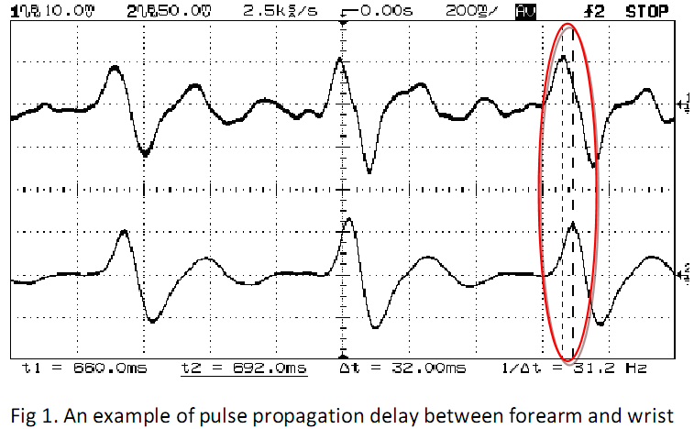
Examples of previous projects
Copyright 2011 Larry A. Beaty. Copying and distribution of this document is permitted provided this notice is retained.
Notes:
Measuring Pulse Transit Time

Slide 11
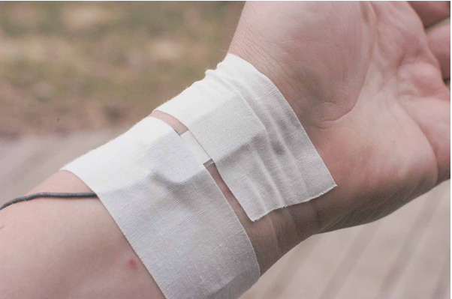
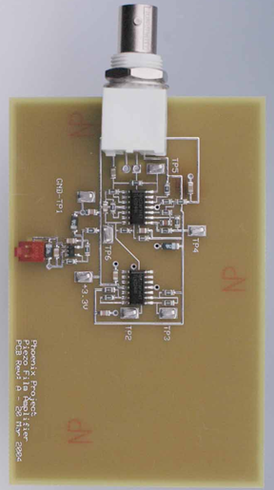
Examples of previous projects
Copyright 2011 Larry A. Beaty. Copying and distribution of this document is permitted provided this notice is retained.
Notes:
Experiments with piezoelectric sensors

Slide 12
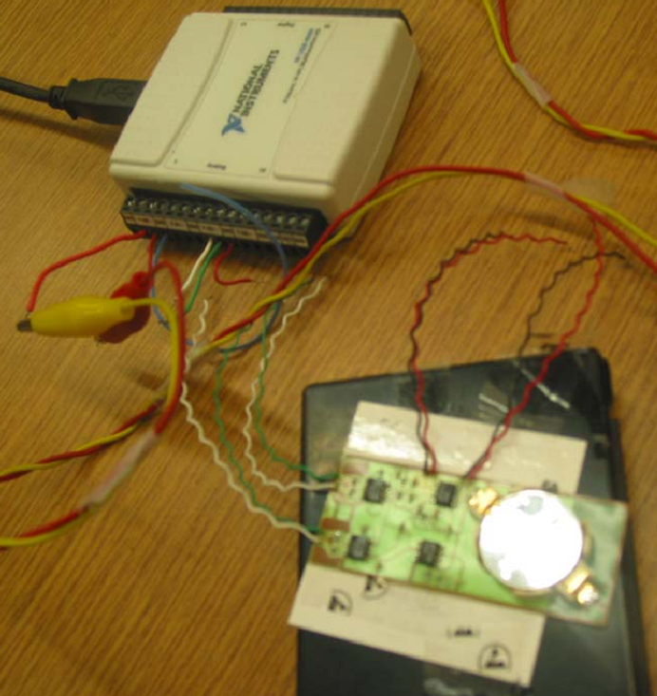
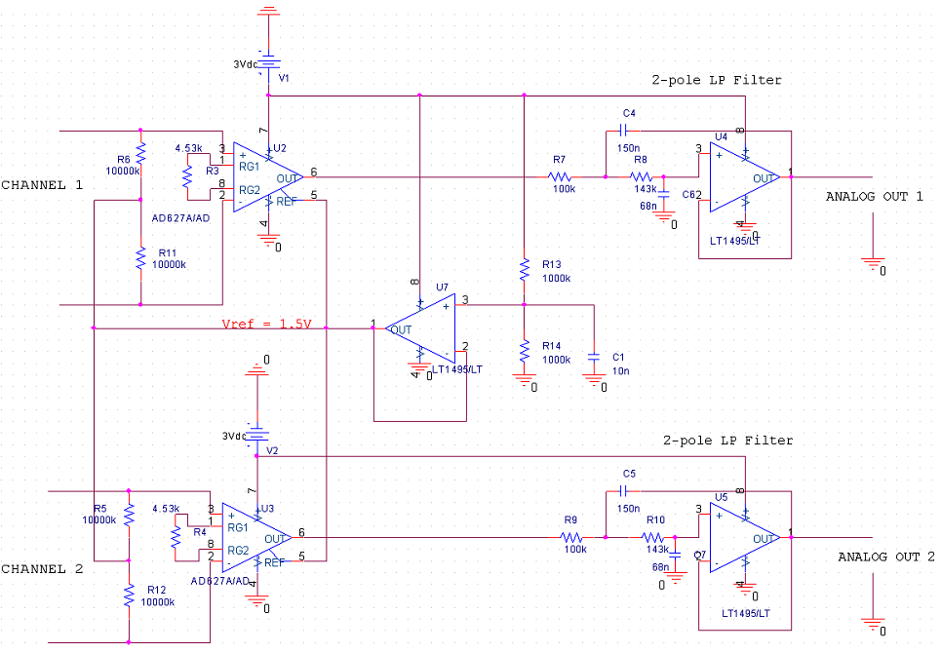
Examples of previous projects
Copyright 2011 Larry A. Beaty. Copying and distribution of this document is permitted provided this notice is retained.
Notes:
Experiments with flexible circuit boards and filtering circuits

Slide 13
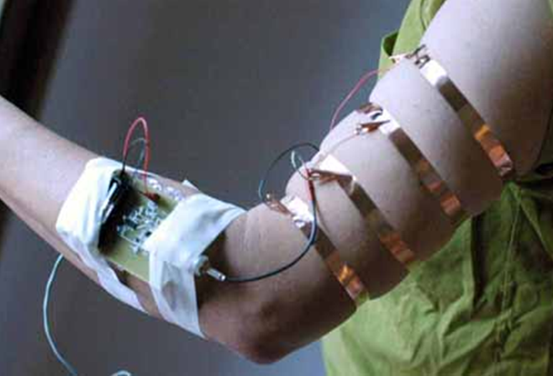
Examples of previous projects
Copyright 2011 Larry A. Beaty. Copying and distribution of this document is permitted provided this notice is retained.
Notes:
Impedance Plethysmograph Sensor Experiment

Slide 14
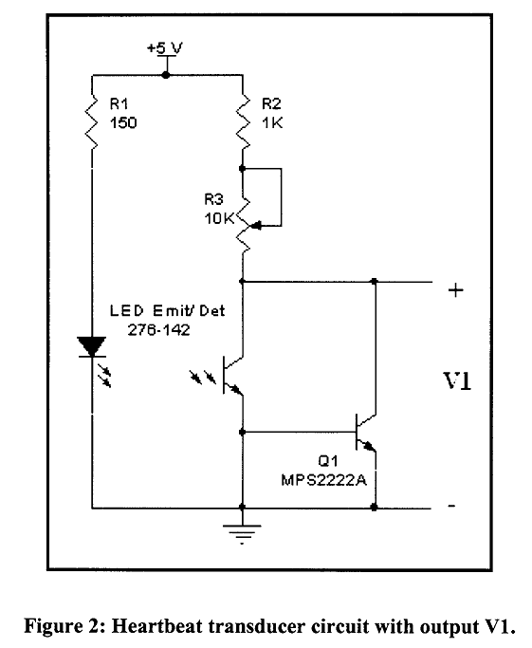
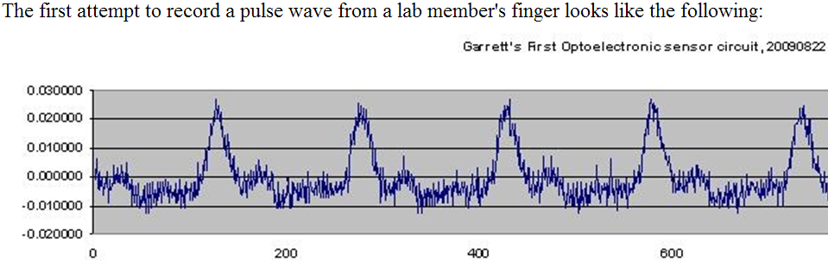
Examples of previous projects
Copyright 2011 Larry A. Beaty. Copying and distribution of this document is permitted provided this notice is retained.
Notes:
An early Infrared Sensor Experiment

Slide 15
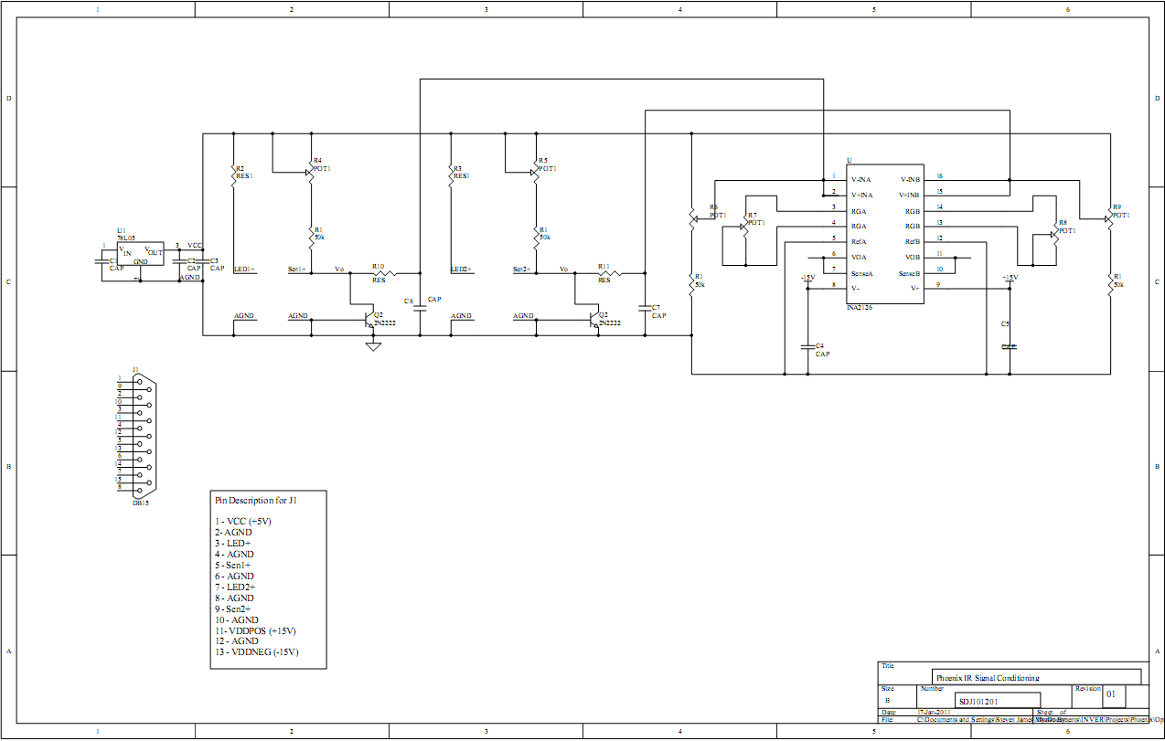
Examples of previous projects
Copyright 2011 Larry A. Beaty. Copying and distribution of this document is permitted provided this notice is retained.
Notes:
A new circuit, inspired by the success of the early Infrared Sensor Experiment. This circuit is being worked on in the lab today (Jan 2011).

Slide 16
Conclusion
We are looking to extend the R&D we’ve done so far, and then productize something from the ongoing research; the student projects are an important part of that.
Dr. Halberg expects this to change healthcare in a major way for all 7 billion people on the planet by preventing and diagnosing diseases we can’t detect today.
Would you like to say that you got an “A” for doing your part on an open source healthcare-related project that went from visualization in the academic world to R&D and then to production?
  Companies like to hire people who can say stuff like that!
Copyright 2011 Larry A. Beaty. Copying and distribution of this document is permitted provided this notice is retained.

